Slide 1
Zero-shot Classification by Deep Learning

Slide 2
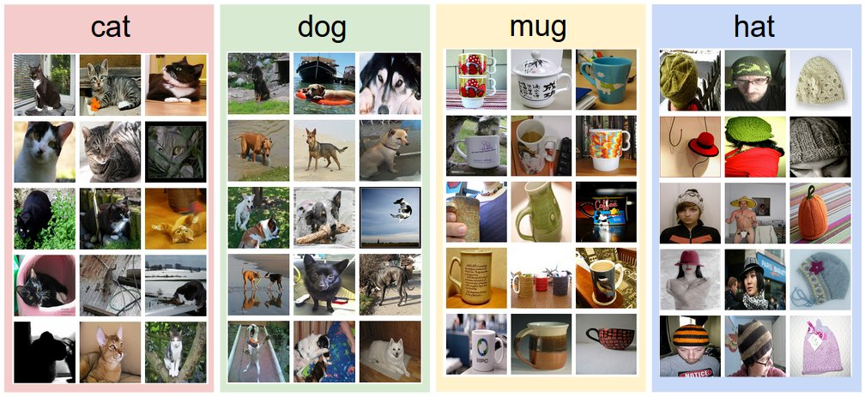
Conventional classification: test and Train classes are joint
Learning Algorithm
Classifier
Classifier
Cat
Dog

Slide 3
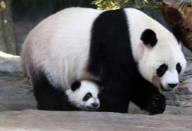
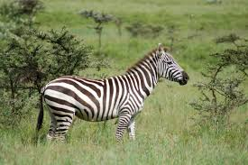
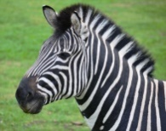


Zero-shot classification: test and train classes and disjoint
Side Info for Cat and Dog:
Attributes. eg. cat has four legs, white colour.
Learning Algorithm
Classifier
Side Info for test data.
Zebra
Classifier
Panda

Slide 4
Zero-shot classification by deep learning
Approach 1: Ridge regression.
Features are obtained from pre-trained deep models such as VGG and GoogLeNET.
Approach 2: Autoencoder
Trained from scratch instead of getting features from pre-trained models.
Approach 3: Deep regression.
Trained from scratch instead of getting features from pre-trained models.

Slide 5
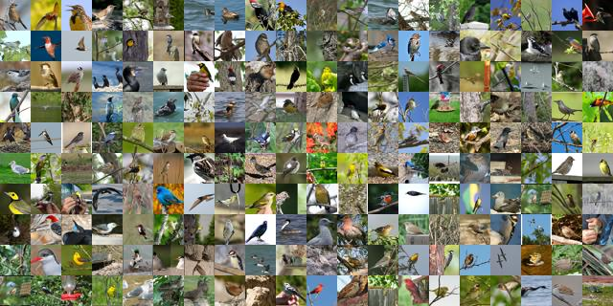
Results
Dataset: CUB dataset is used
http://www.vision.caltech.edu/visipedia/CUB-200.html

Slide 6
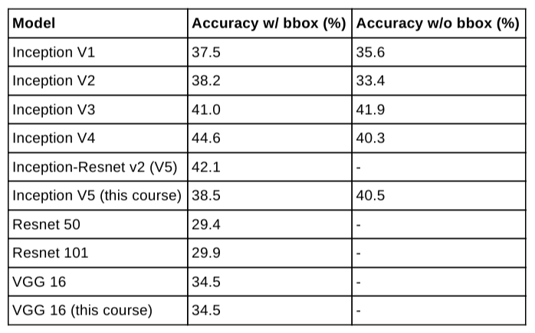
Results-1
Approach 1: Ridge regression.
Features are obtained from VGG and GoogLeNet pre-trained models.
bbox is a bounding box. The dataset also provides bbox for images.

Slide 7
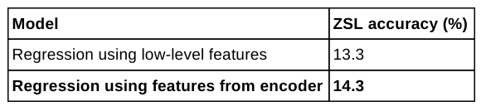
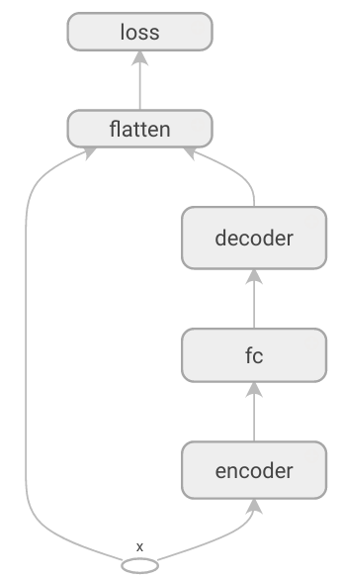
Results-2
Approach 2: Autoencoder.
Features are learned using autoencoder. Then, encoder part is used to extract features.

Slide 8
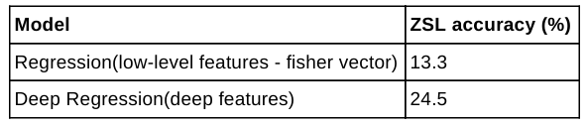
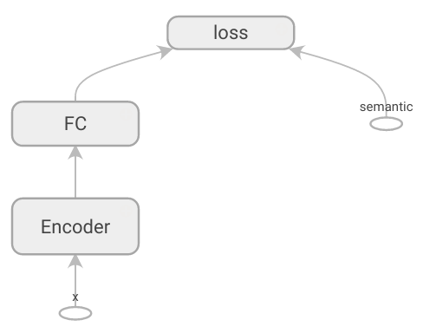
Results-3
Approach 3: Deep regression.
Features are obtained by training deep regression model from scratch.

